Slide 1

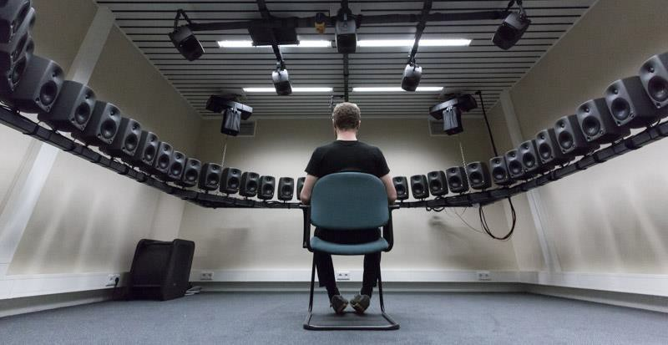
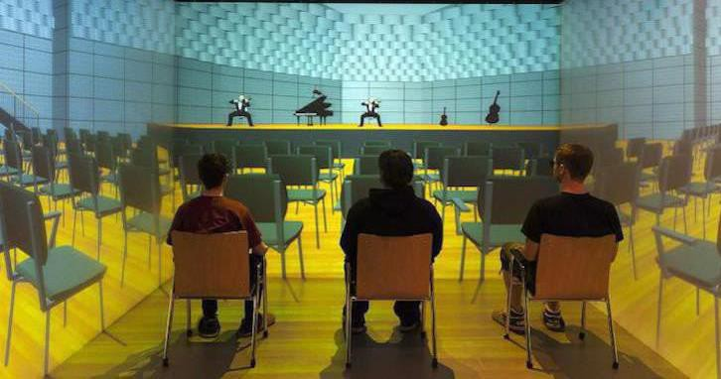
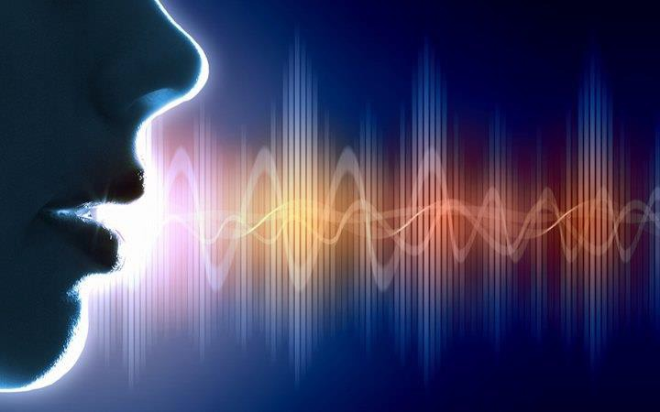
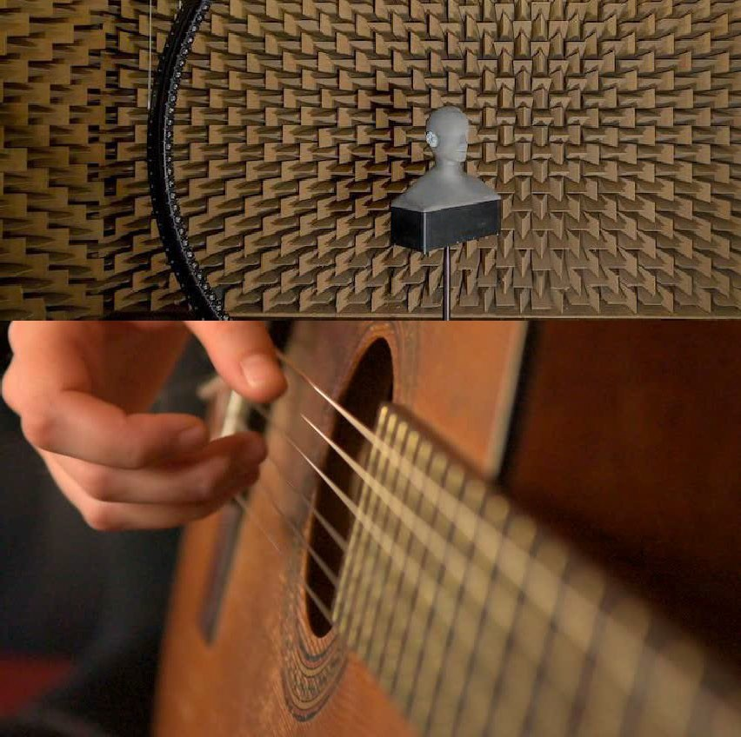
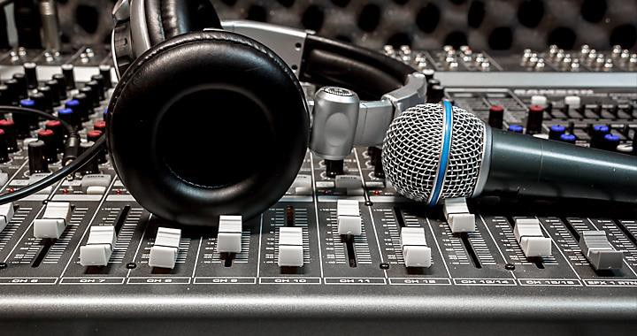
The Science of Sound
Module 2
Lecture 3 – Sound Perception
Tanmayee Pathre (t.u.pathre@tue.nl)
lectures adapted from the textbook Building Acoustics Group
Pictures from Google

Slide 2
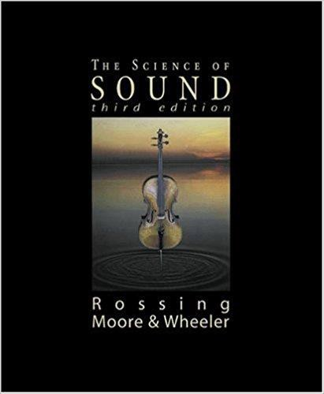
Contents
Range of Hearing
Anatomy of ear
Spatial Hearing
Perceptual correlates of sound –
Pitch
Timbre
Loudness
The Decibel Scale
Masking and Critical Bands

Slide 3

Learning Objectives
Parameters of range of hearing system
Some basic anatomy and physiology of human hearing system
Spatial hearing – cues for sound localization
Understanding and experiencing the perceptual quantities – Loudness, Pitch and Timbre
Concept of Masking and Critical Bands

Slide 4
Range of Hearing

Slide 5
Range of hearing
Human Auditory System – A fascinating system
Response to a range of pressures, frequencies and intensities
Audible frequency range for humans – 20 Hz to 20,000 Hz.
Frequency selectivity
Pick solo instrument from an orchestra
Hear your friend in a room full of people

Slide 6
Range of hearing
Ear insensitive to low frequencies such as 100 Hz
Highly sensitive between frequency range 2000 Hz to 5000 Hz.
Notes:
Review question in Week

Slide 7
Anatomy of human ear

Slide 8
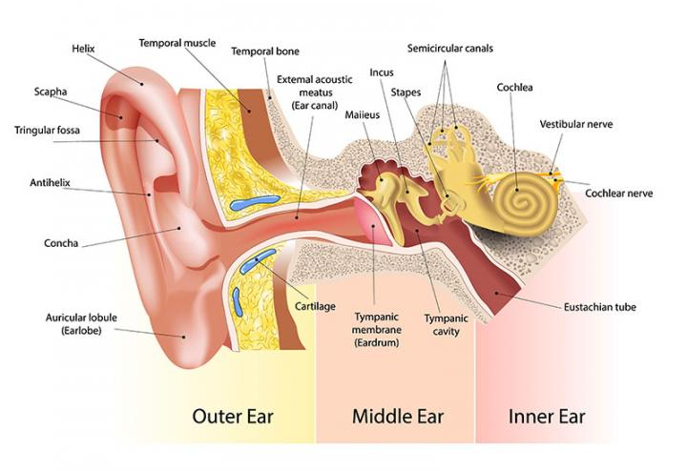
Anatomy of ear
Acoustical
Mechanical
Electrical

Slide 9
Anatomy of ear

Slide 10
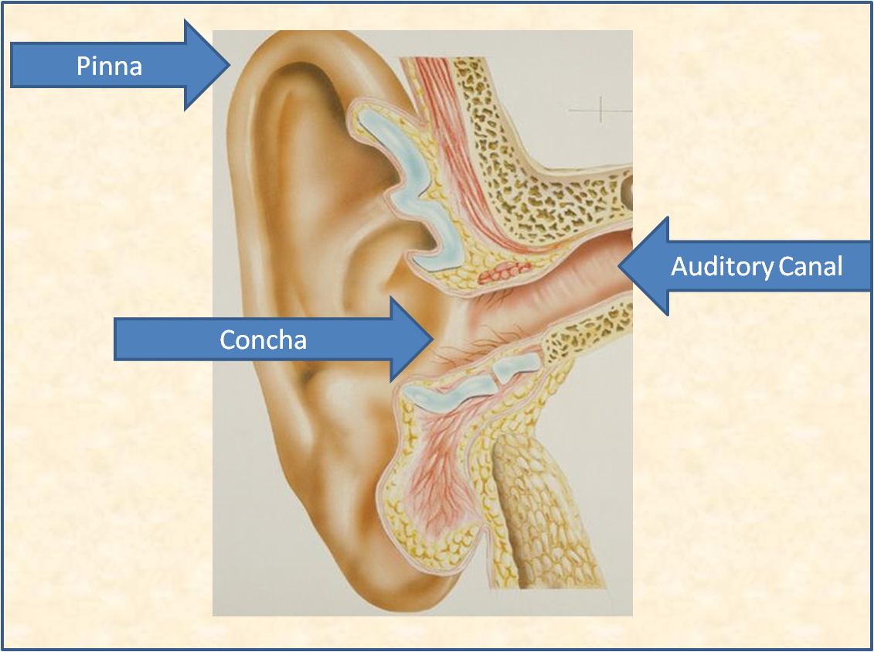
Anatomy of Ear
The Outer ear
Pinna
Irregular grooves and ridges – Why?
Auditory canal or Ear canal
Almost like an open-close pipe
Source: External
Notes:
Why do we need an outer ear? What if we did not have an outer ear?

Slide 11
Anatomy of Ear
The Outer ear
Pinna
Protection to sensitive inner ear
Acts as funnel – collecting sound
Irregular shape of pinna → Sound localization → Provides physical cues for locations
Auditory canal or Ear canal
Ear canal resonance → Boosts hearing sensitivity in the range 2000 Hz to 5000 Hz.

Slide 12
Anatomy of Ear – Middle Ear

Slide 13
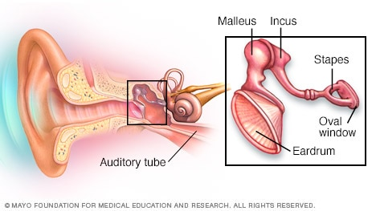
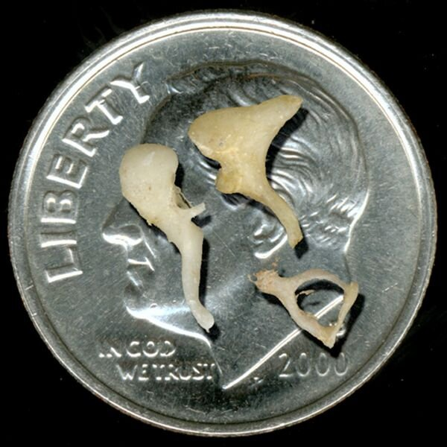
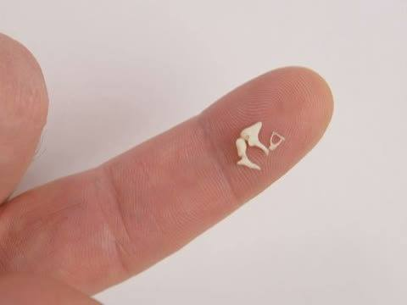
Anatomy of Ear – Middle Ear
The Middle ear
Tympanic membrane/Ear drum
Three bones – Ossicles
Malles (25 mg)
Incus (30 mg)
Stapes (3 mg)
Source: Funkids
Source: www.chadruffinmd.com/endoscopic-ear-surgery

Slide 14
Anatomy of Ear – Middle Ear
The Middle ear - Functions
Impedance Transformer → Transmission of tympanic membrane (ear drum) movements to the fluid which fills the cochlea without significant loss of energy
Protects the hearing system from loud sounds – Acoustic Reflex
Pressure equalization
Source: Earplanes

Slide 15
Anatomy of Ear – Middle Ear
The Middle ear – Impedance Transformer
Act as a lever which changes pressure from eardrum to the oval window on inner ear.
Lever effect of malleus and incus
Area difference between tympanic membrane
Source: Acoustics and Psychoacoustics, Book

Slide 16
Anatomy of Ear – Middle Ear
The Middle ear – Acoustic Reflex
Ear muscles automatically contract in response to sound levels greater than 75 dB SPL
Contraction stiffens the ossicular chain and thus impedance increases.
Reduction in efficiency with which vibrations are transmitted from ear drum to inner ear

Slide 17
Anatomy of Ear – Middle Ear
The Middle ear – Pressure equalization
Ear drum makes air tight seal between middle and outer parts of ear → pressure equalization
Eustachian Tube – Connects middle ear cavity to nasopharynx
Ears “pop” when Eustachian tube opens
Change in air-pressure during landing and take off (change in altitude)

Slide 18
Anatomy of Ear – Inner Ear

Slide 19
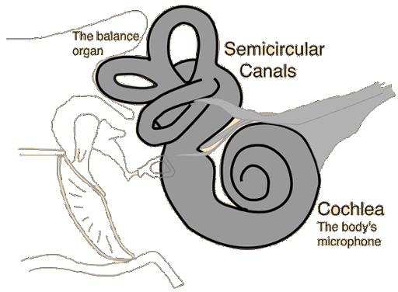
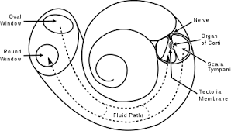
Anatomy of Ear – Inner Ear
The Inner ear
Semi-circular canals – Body’s horizontal and vertical detectors → Sense of balance
Cochlea – Bony snail like structure filled with fluid → Related to hearing
base
apex
Source: Wikipedia
Source: Hyperphysics

Slide 20
Anatomy of Ear – Inner Ear
The Inner ear - Cochlea
Converts mechanical vibrations into neural impulses that can be encoded by the brain
Source: C.J.Plack

Slide 21
Anatomy of Ear – Inner Ear
The Inner ear
Organ of corti – Seat of hearing
Consists of Hair cells. These hair cells are attached to nerve fibres.
Outer hair cells – 12,000 in a single row → Amplification of sound
Inner hair cells – 4000 in a single row→ Transmitting signals to nerve fibers
Source: C.J.Plack

Slide 22
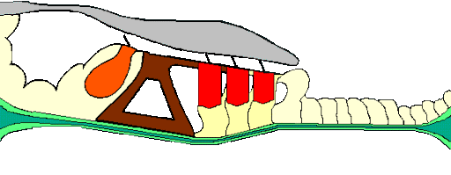
Anatomy of Ear – Inner Ear
The Inner ear
Each hair cell has many hairs or stereocilia.
Stereocilia are bent when basiliar membrane responds to sound
Bending of stereocilia stimulates hair cells, which in turn excites neurons in auditory nerve →
Tectoral membrane
Stereocilia
Basilar membrane
Auditory nerve
Inner hair cells
Outer hair cells
Source: Cochlear Mechnanics

Slide 23
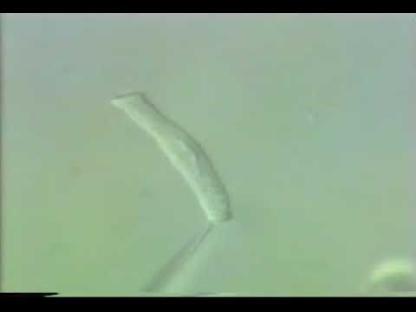
Anatomy of Ear – Inner Ear
The Inner ear – The Dancing Hair cell
https://www.youtube.com/watch?v=wKEhjpqpzCE
Source: YouTube

Slide 24
Anatomy of Ear – Inner Ear
The Inner ear – Basilar membrane
Basilar Membrane – frequency analyzer
Narrow and thin at the base, wider and thicker at the apex.
Response to high frequencies at the base, low frequencies at the apex
Source: C.J.Plack

Slide 25
Anatomy of Ear – Inner Ear
The Inner ear
Stapes vibrate against the oval window, hydraulic waves transmitted via scala vestibuli.
Pressure waves travel via the cochlear fluid towards the round window causing ripples on the membrane

Slide 26
Anatomy of Ear – Inner Ear
The Inner ear – Basilar membrane
Travelling wave on the entire membrane
High frequencies create ripples at the base, low frequencies create ripples at the apex.
Source: C.J.Plack

Slide 27
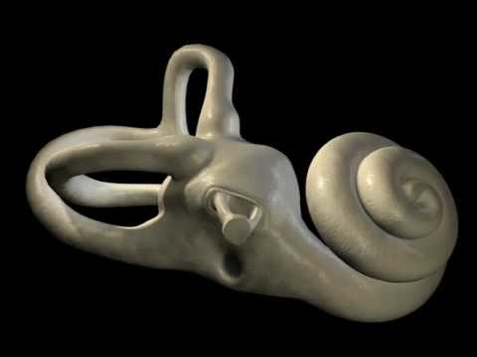
Sound propagation inside the ear – in a nutshell
https://youtu.be/46aNGGNPm7s

Slide 28
Spatial Hearing

Slide 29
Spatial Hearing
Binaural Hearing
Binaural hearing → Sound localization
Enhancement of ability to sense the direction of sound source
Physical basis for these cues
Distance between ears (approximately 18 cm)
The head in between the ears (acoustic shadow)
Spectral filtering by outer ear (pinna)
Basic cues
Interaural differences in time (ITD)
Interaural differences in level (ILD)

Slide 30
Spatial Hearing
Interaural Time Differences
Difference between arrival time between two ears
Low frequency components are present – ITD most important cue for sound source localization
Where c is the speed of sound

Slide 31
Spatial Hearing
Interaural Level Differences
Difference in sound level between two ears
ILD arise because of Head-shadow effect – sound needs to bend around the head
Low frequencies diffract more than high frequencies, so the level cue is
most salient at high frequencies.

Slide 32
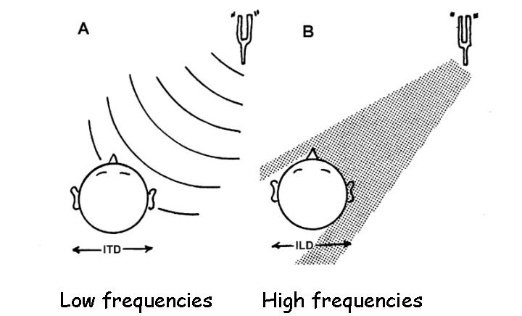
Spatial Hearing
Which cue is dominant? – Duplex Theory (Lord Rayleigh, 1907)
ITDs are used at low frequencies
ILDs are used at high frequencies
Transition region around 2 kHz

Slide 33
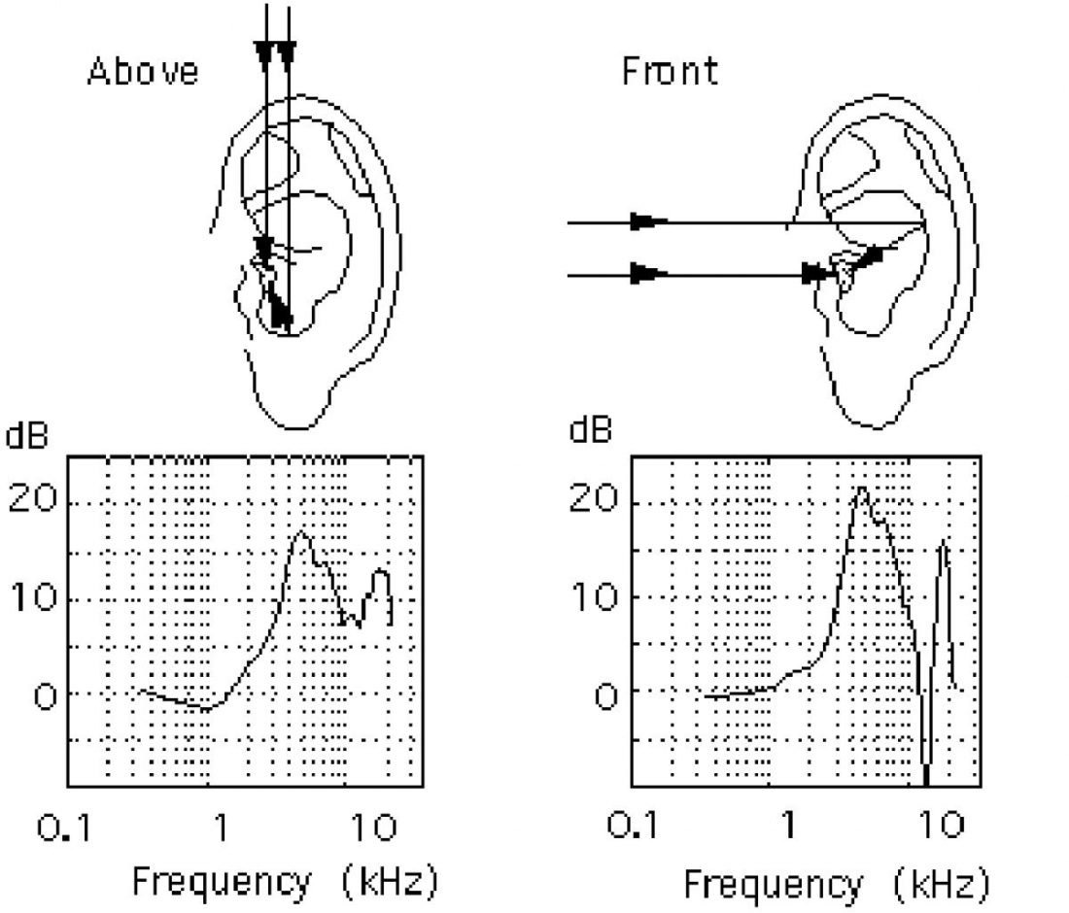
Spatial Hearing
Spectral filtering by outer ear (pinna)
At frequencies above 5000 Hz, Pinna helps in sound localization.
Particularly from sound coming from front and back

Slide 34
Spatial Hearing
Applications
Surround Sound: 5.1, 7.1, 22.2
Higher-Order-Ambisonics (HOA)
Wave Field Synthesis (WFS)
3D Sound - Immersive Audio – Video games, Virtual Reality

Slide 35

Spatial Hearing
Listening Demonstration
https://www.youtube.com/watch?v=IUDTlvagjJA

Slide 36
Pitch

Slide 37
Pitch
Pitch
Pitch is defined as that attribute of auditory perception which allows to order sounds on a scale from low to high. (ANSI definition)
Pitch and frequency are not the same not even for a pure tone (sinusoid)
Perceived pitch of pure tones can vary with level
Sound with very different spectral composition can induce the same pitch percept (example: musical instruments)
Source: Plomp CD Perceptual Audio Demonstrations

Slide 38


Pitch
Listening Demonstration – Pitch
In complex tones, the fundamental frequency determines the pitch, even if this component is absent in the complex.
Three demonstrations were created to illustrate pitch as an auditory phenomenon relating to frequency.
This demonstration investigates how pitch is perceived in time.
Each track plays time bursts of sound.
Initially the tones will sound like pops or blips, but as the tones increase in time duration they will begin to have pitch. Each demonstration uses a different frequency of tone.
Track 1
Track 2
Track 3
Source: Perceptual Audio Demonstrations

Slide 39
Timbre

Slide 40
Timbre
Timbre
Timbre – Tone colour or sound quality
Auditory percept which allows to judge that two stationary sounds which have equal loudness, pitch, duration, and spatial direction sound different
Timbre is thus mainly dependent on the spectral composition of a sound, → amplitude spectrum, but also phase of components can contribute to timbre
Musical instruments have different timbres – flute does not sound same as saxophone!!!
Timbre also is the basis for distinction between different vowels in speech

Slide 41
Timbre
Listening Demonstration – Timbre
Demonstration to understand differences in Timbre
Track 1
Track 2
Source: Plomp CD and Perceptual Audio Demonstrations

Slide 42
The Decibel Scale

Slide 43
Range of hearing
The Decibel (dB) scale
Enormous range of pressures and intensities → Huge numbers
Specify intensity in logarithmic units – decibels (dB)
Notes:
Review question in Week

Slide 44
Sound Level
Source: C.J.Plack
Notes:
Review question in Week

Slide 45
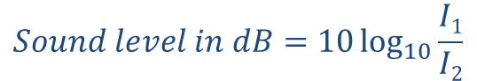

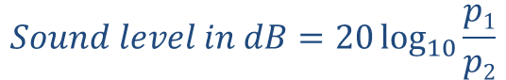
Sound Level
The Decibel (dB) – A little more
dB – Logarithmic way of describing a ratio
The ratio may be of power (P), sound pressure(p), intensity(I) or voltage.
The factor of 10 which puts the ‘deci’ in decibel: level difference in bels (named after Alexander Graham Bell).
$$Sound level in dB=10\log_{10}{\frac{P1}{P2}}$$
$$Sound level in dB=10\log_{10}{\frac{I1}{I2}}$$
$$Sound level in dB=20\log_{10}{\frac{p1}{p2}}$$
Notes:
Review question in Week

Slide 46
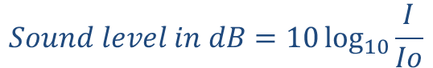

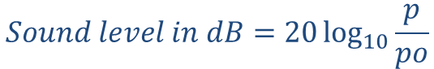
Sound Level
The Decibel (dB)
Sound level – Power
Sound level – Intensity
Sound level - Pressure
$$Sound level in dB=10\log_{10}{\frac{P}{Po}}$$
Where P_{o} = 10⁻¹² W
$$Sound level in dB=10\log_{10}{\frac{I}{Io}}$$
Where I_{o} = 10⁻¹² W/m²
$$Sound level in dB=20\log_{10}{\frac{p}{po}}$$
Where p_{o} = 2x10⁻⁵ N/m²
Notes:
Review question in Week

Slide 47
Sound Level
Listening demonstration – Examples
Ticks of a clock (30 dB)
Painting (40 dB)
Cutting paper (50 dB)
Washing hands (60 dB)
Toilett flush (70 dB)
Vacuum cleaner (noisy model, 80 dB)
Stone drill (100 dB)
Source: SUVA CD track 18

Slide 48

Loudness
Listening Demonstration – Level
Level differences of 0 tot +10 dB between successive sounds
Relative levels of individual sounds
Try to find out which difference leads to a perceivable difference
0 dB, +1 dB, 0 dB, +3 dB, 0 dB, +6 dB, 0 dB,+10 dB, 0 dB
Source: SUVA CD track 14

Slide 49
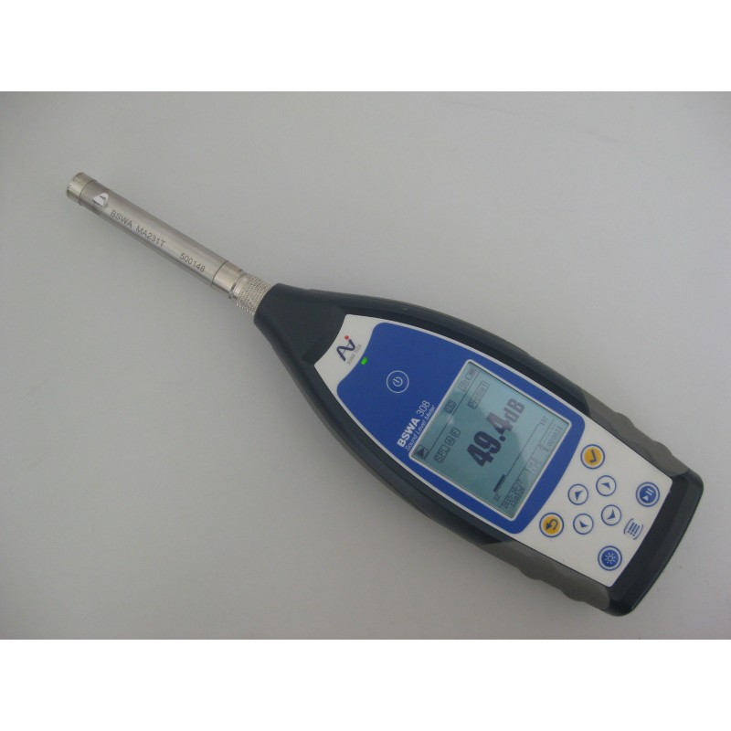
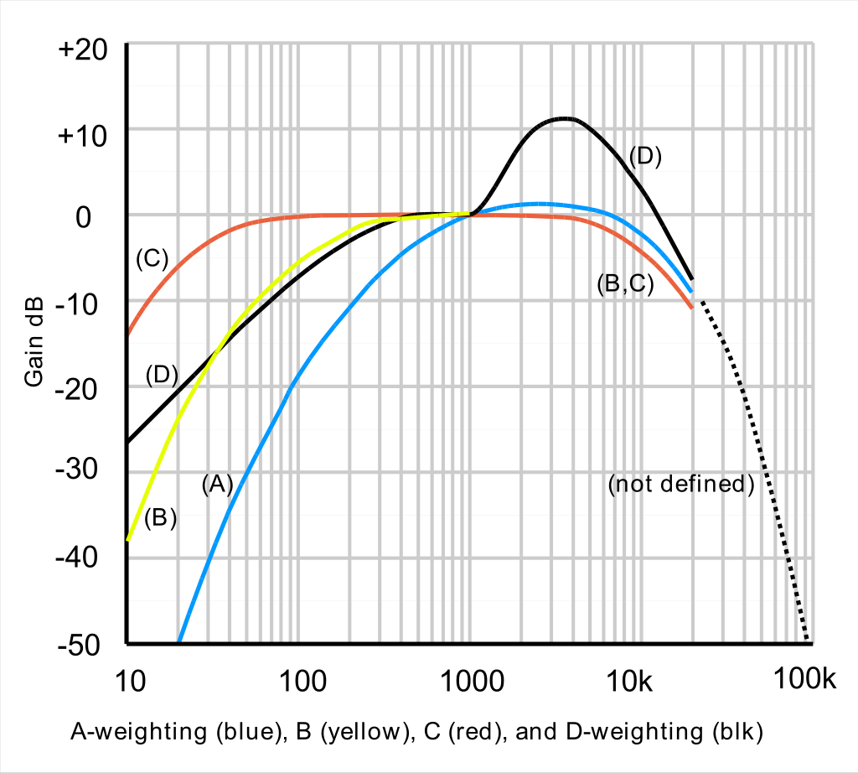
Loudness
Measuring Sound Pressure Level
Use of Sound Level Meter
Provided with Different Weightings
Source: abcgeluid
Source: Wikipedia

Slide 50
Different Weightings of Sound
A weighting dB (A)
Most common weighting. dB(A) roughly corresponds to the inverse of the 40 dB (at 1 kHz) equal-loudness curve for the human ear.
B – Weighting dB (B)
Rarely used
C Weighting dB (C)
Suitable for subjective measurements only for moderate to high sound levels
Notes:
Negative gain means the output is inverted from the input. For the gain to be negative, the output would have to go down when the input goes up, which is clearly not happening in your case.

Slide 51
Loudness

Slide 52
Sound Level
Loudness
Loudness – perceptual quantity primarily related to sound intensity
Categorization of sounds by variation in intensity
Variation across time and frequency
Notes:
Review question in Week

Slide 53
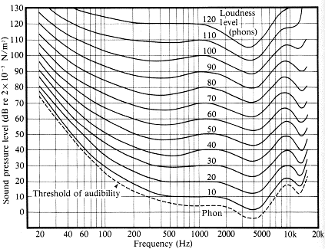
Range of hearing
Fletcher-Munson Curves Equal Loudness contours
Source: StudioTone
Each curve represents the levels and frequencies of pure tones of equal loudness, measured relative to a 1000-Hz pure tone.
A pure tone corresponding to a point on a given curve will sound as loud as a pure tone at any other point on the same
curve. The level of the 1000-Hz tone for each curve (in dB SPL) is shown on the figure above each loudness contour.

Slide 54
Masking and Critical Bands
Listening Demonstration – Loudness
Demonstration shows that the perceived loudness of tones varies at equal sound intensity.
Source: Perceptual Audio Demonstrations

Slide 55
Masking and Critical Bands

Slide 56
Masking and Critical Bands
Masking
Masking is the process by which the detection threshold of a sound (called ‘the signal’) is increased by the presence of another sound (called ‘the masker’).
Masking describes the effect that a stimulus, which is clearly perceivable (audible) when presented in isolation, becomes unperceivable (inaudible) in the presence of another stimulus

Slide 57
Masking and Critical Bands
Fletcher Experiment, Critical Band Estimation
Measure threshold of detectability of a tone masked by bandpass noise centred spectrally around the tone
Measure thresholds as a function of masker bandwidth
SPL
test signal
masked threshold
masker
*
frequency
bandwidth

Slide 58
Masking and Critical Bands
Fletcher Experiment, Critical Band Estimation
Measure threshold of detectability of a tone masked by bandpass noise centred spectrally around the tone
Measure thresholds as a function of masker bandwidth
SPL
test signal
masked threshold
*
masker
*
frequency
bandwidth

Slide 59
Masking and Critical Bands
Fletcher Experiment, Critical Band Estimation
Measure threshold of detectability of a tone masked by bandpass noise centred spectrally around the tone
Measure thresholds as a function of masker bandwidth
SPL
test signal
masked threshold
*
*
masker
*
frequency
bandwidth

Slide 60
Masking and Critical Bands
Fletcher Experiment, Critical Band Estimation
Measure threshold of detectability of a tone masked by bandpass noise centred spectrally around the tone
Measure thresholds as a function of masker bandwidth
SPL
test signal
masked threshold
*
*
*
masker
*
frequency
bandwidth

Slide 61
Masking and Critical Bands
Fletcher Experiment, Critical Band Estimation
Measure threshold of detectability of a tone masked by bandpass noise centred spectrally around the tone
Measure thresholds as a function of masker bandwidth
SPL
test signal
masked threshold
*
*
*
*
masker
*
frequency
critical bandwidth
bandwidth

Slide 62
Masking and Critical Bands
Few Findings from Masking Experiment
Pure tones that are close together in frequency mask each other better than those widely separated.
Pure tones also mask higher frequencies better than lower frequencies.
Tone of greater intensity masks a broader ranger of tones than a tone of less intensity

Slide 63
Masking and Critical Bands
Listening Demonstration – Masking
Pure tones that are close together in frequency mask each other better than those widely separated.
A single tone is played, followed by the same tone and a higher frequency tone. The higher frequency tone is reduced in intensity first by 12 dB, then by steps of 5 dB. The sequence above is repeated twice. The second time the frequency separation between the tones is increased
Pure tones also mask higher frequencies better than lower frequencies.
High Frequencies masked →
Low frequencies are masked →
Source: Perceptual Audio Demonstrations

Slide 64
Masking and Critical Bands
Listening Demonstration – Masking
Tone of greater intensity masks a broader ranger of tones than a tone of less intensity
A single tone is played, followed by the same tone and a higher frequency tone. The higher frequency tone is reduced in intensity first by 10 dB, then by steps of 3 dB. The sequence above is repeated twice, the second time increasing the intensity of the single tone by 28 dB.
Source: Perceptual Audio Demonstrations

Slide 65
Wrap up
Take away message
Overview of Human Auditory system
Spatial Hearing → Sound Localization
Loudness, Pitch and Timbre – Perceptual Correlates of sound
Decibel Scale → Ratio → Pressure, Intensity, Power
Masking and Critical Band → Estimation of Auditory filter

Slide 66
Questions?
Pictures from Google

